Slide 1
SVM CLASSIFICATION
FOR SENTIMENT ANALYSIS OF YOUTUBE COMMENTS
Brian Lee 12623187
ZHU Jiawei 12627010
James XIE Ziyang 12998410
Yeung Cho Ho 12963225

Slide 2
Presentation Flow
Data Cleaning
Slide 5
Lowercasing
Removing special characters in excel
Problem Description, Tabulation
Slide 3-4
SVM and Naive Bayes Classifier
Slide 10-11
Data Preprocessing
Slide 6-9
Conclusion, Limitation
Slide 18
L1 and L2 Logistic Regression
Slide 16-17
Performance Metrics
Slide 12-15

Slide 3
Problem Description, Research Objective
Youtube Comments
API restrictions → Daily request limit, quota limit
YouTube Page structure website may change over time → cause scraping code to fail
Diversity of comments → Comments may have different languages, vocabulary, and cultural backgrounds
Sentiment Analysis
Unsupervised learning → Comment data does not have any emotion tags → cause interpretive difficulties
Implicit → Difficulty in effectively judging ironic comments
Research Objective
Sentiment trend analysis → uncover emotional changes caused by specific events, topics or content

Slide 4
Tabulation
Dataset “ENGLISH_youtube_comments” csv file is implemented, with 213 records
Dataset link: https://www.kaggle.com/code/ahmedshahriarsakib/scrape-youtube-comments-for-free-no-google-api/output
Data cleaning and preprocessing are conducted.
Plots used: Lasso, Ridge, Confusion Matrix

Slide 5
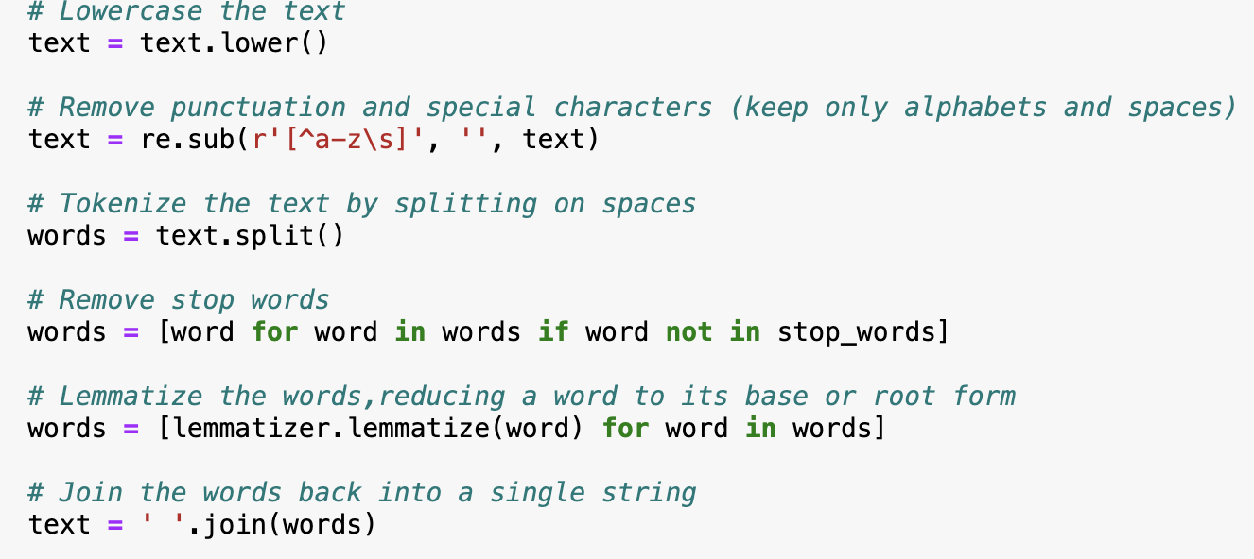
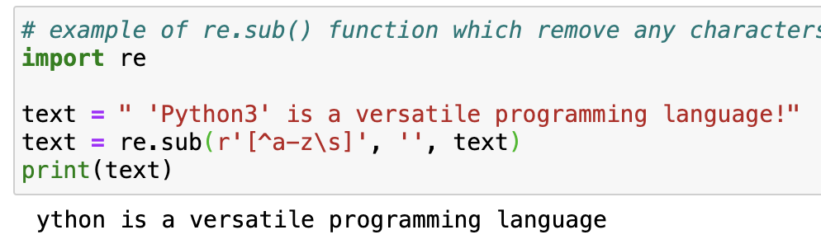
Data Cleaning
Lowercasing
Removing special character
example
Figure 1 Lowercasing
Figure 2 Character Removal

Slide 6
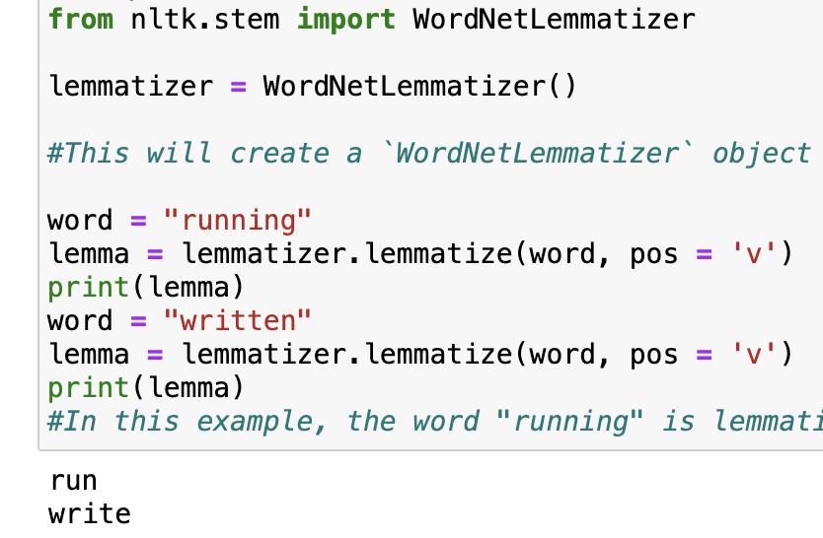
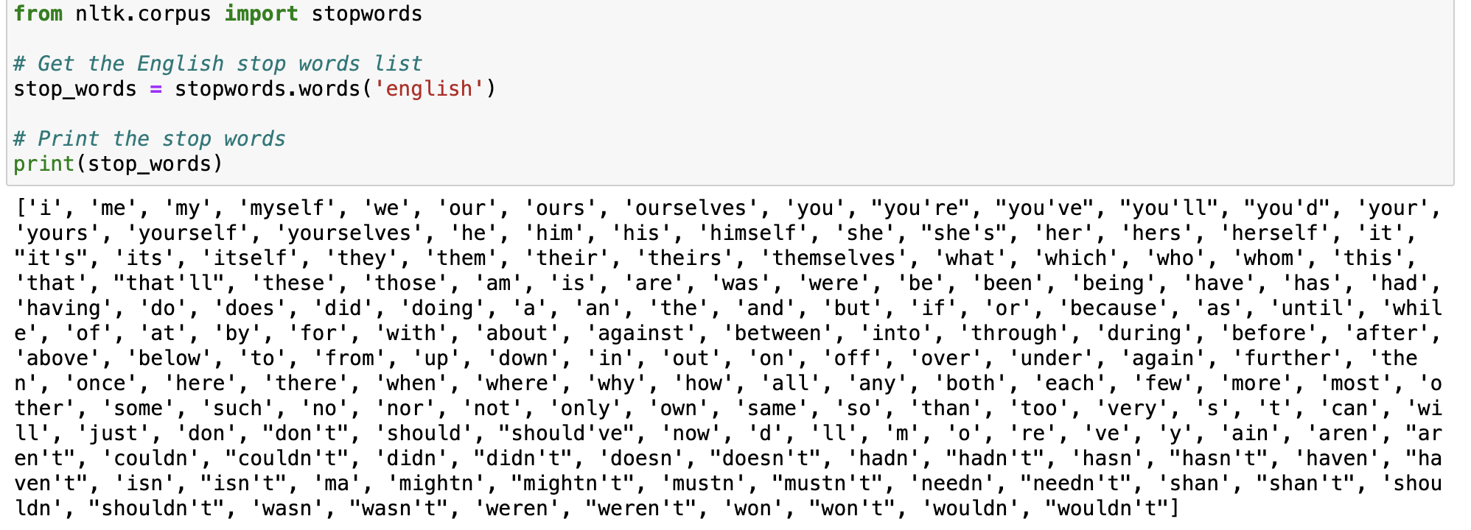
Data Preprocessing
Tokenizing
Removing stop words
Lemmatizing
Joining words back together
Figure 3 stop words
Figure 4 Lemmatization

Slide 7
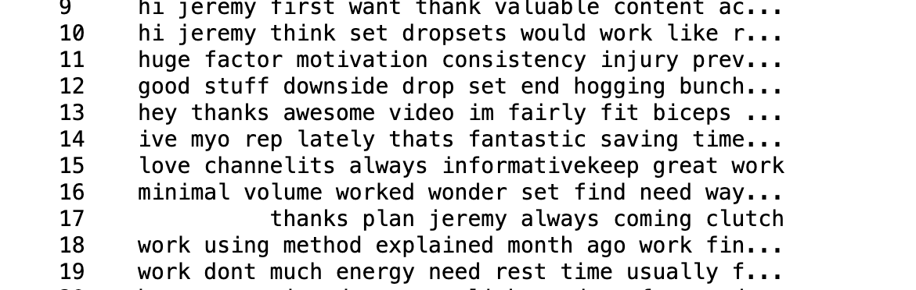
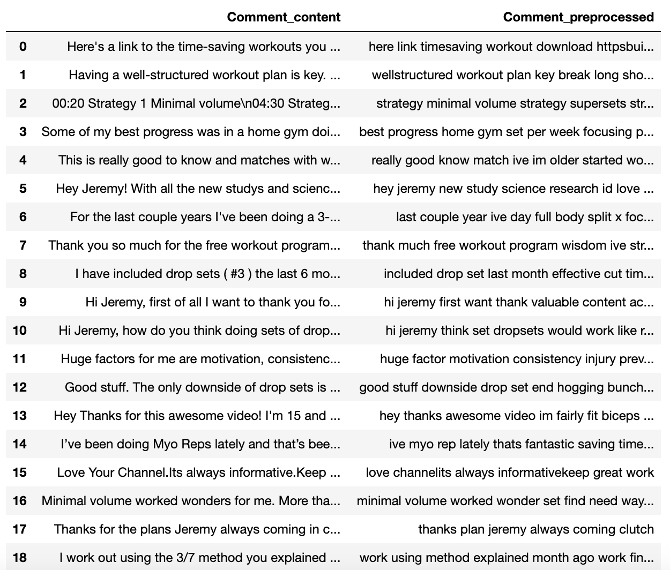
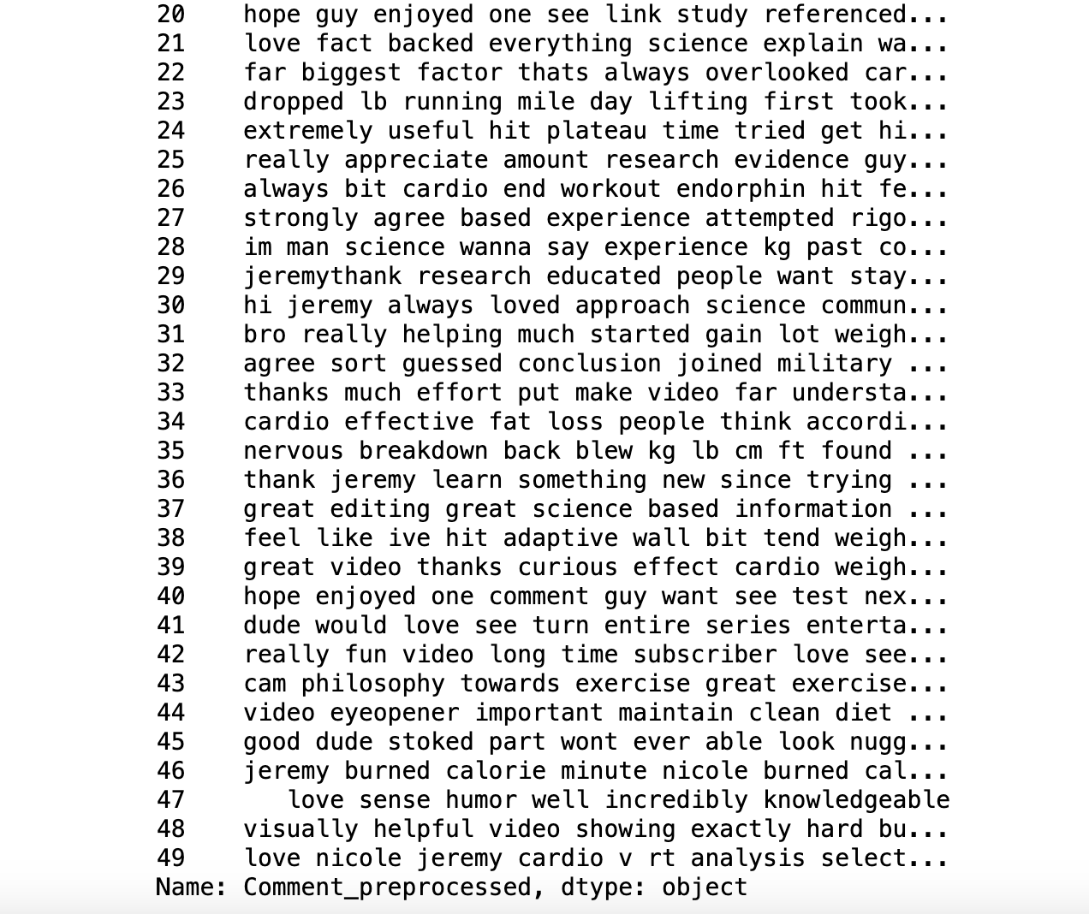
Original
VS
Preprocessed
Figure 5 After data cleaning and preprocessing
Figure 6 Original vs Preprocessed Comments

Slide 8
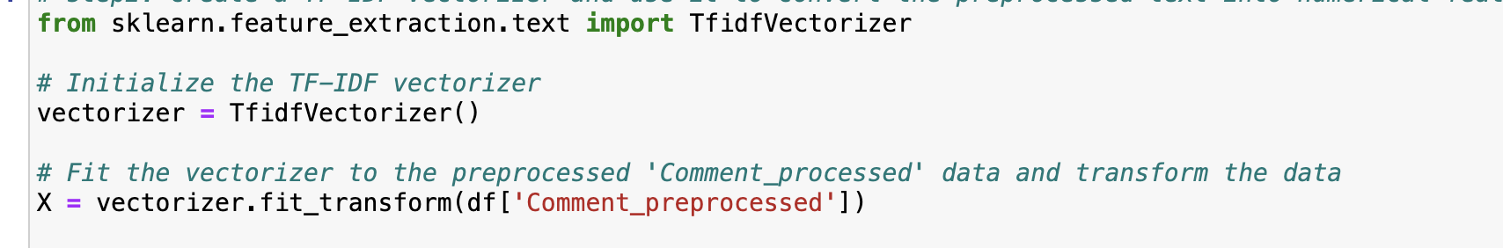
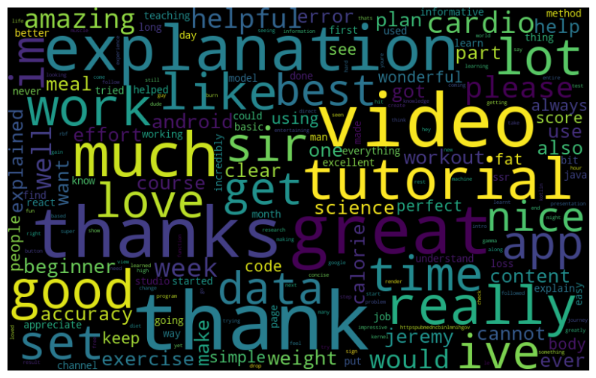
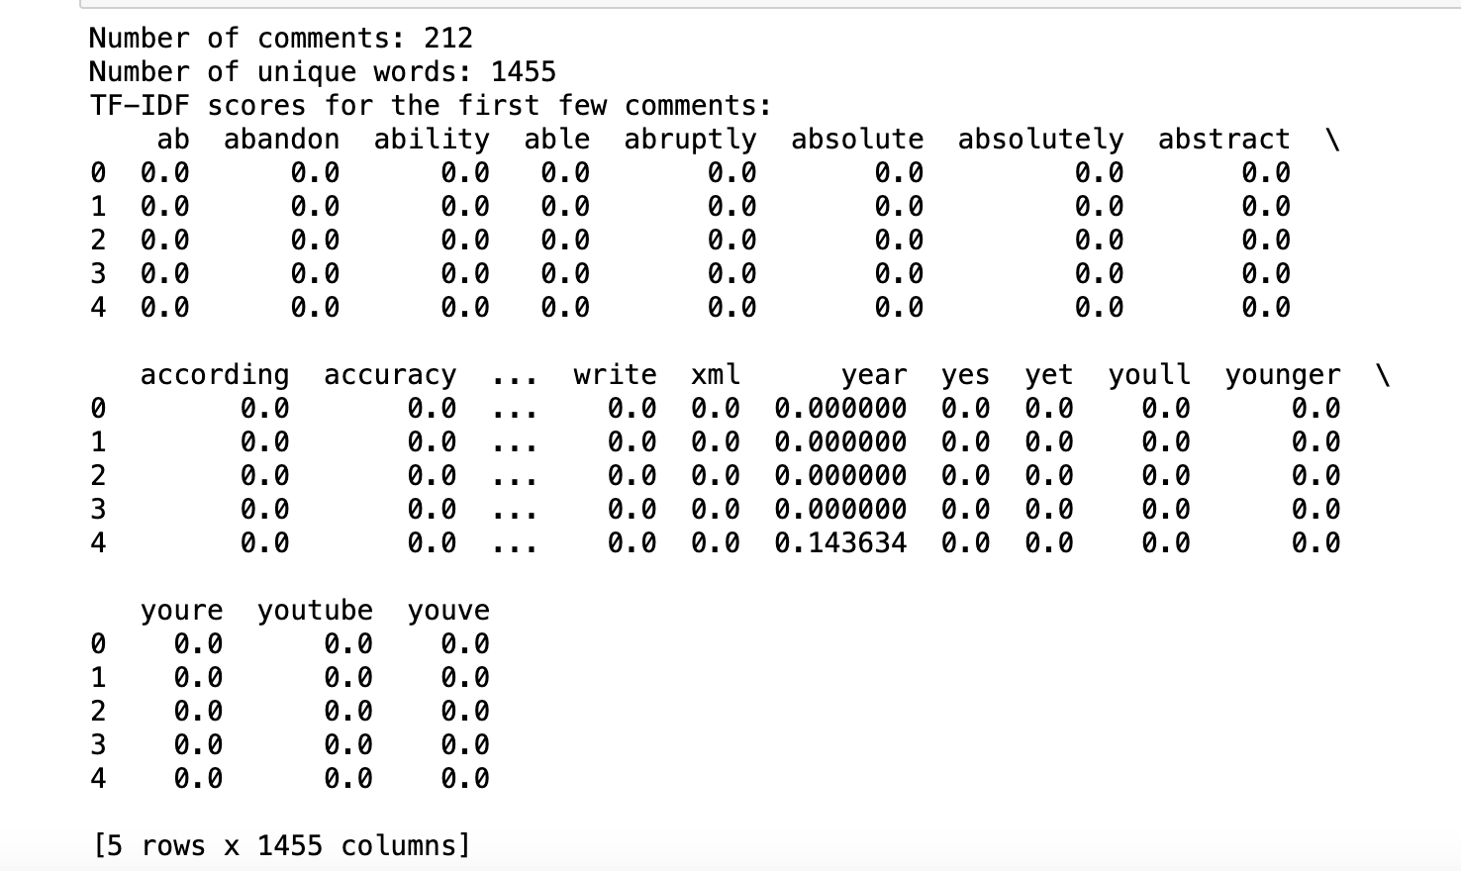
TF-IDF Vectorization
Figure 7a and 7b TF-IDF Vectorization
Figure 8 Word visualization of the the TF-IDF scores

Slide 9
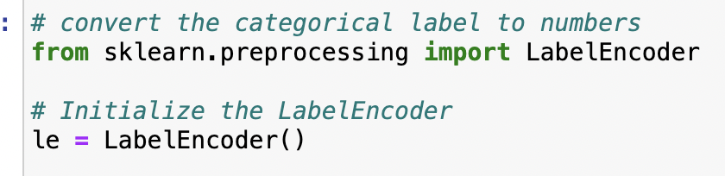

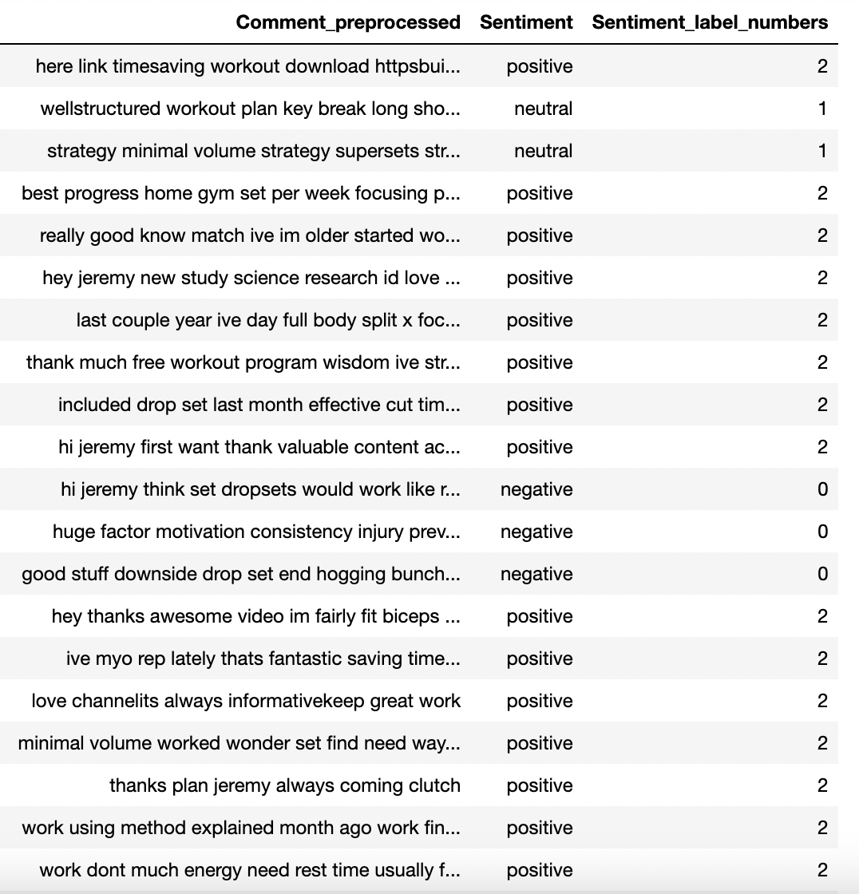
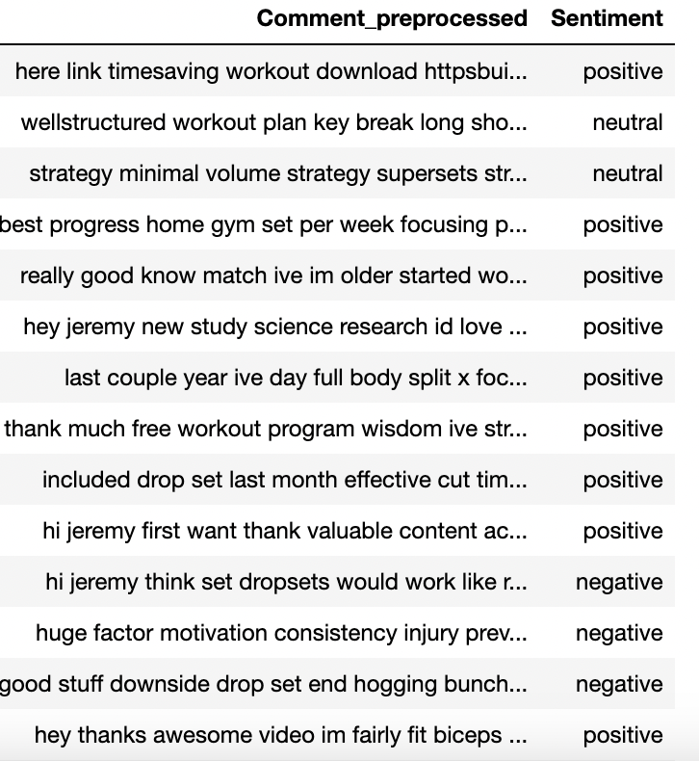
Label Encoding
Figure 10 Sentiments convert to numbers
Figure 9 labeled sentiments

Slide 10
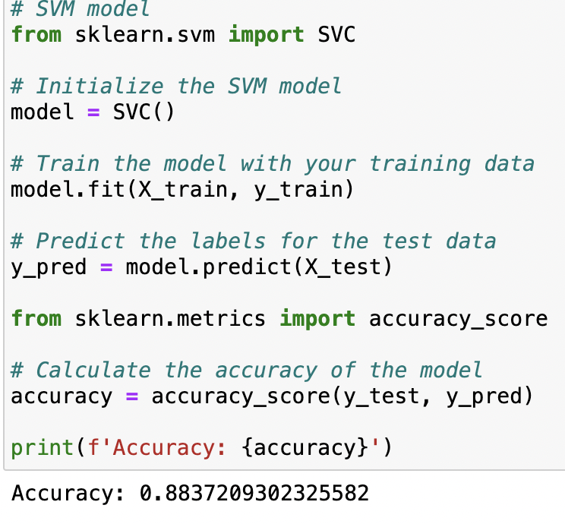
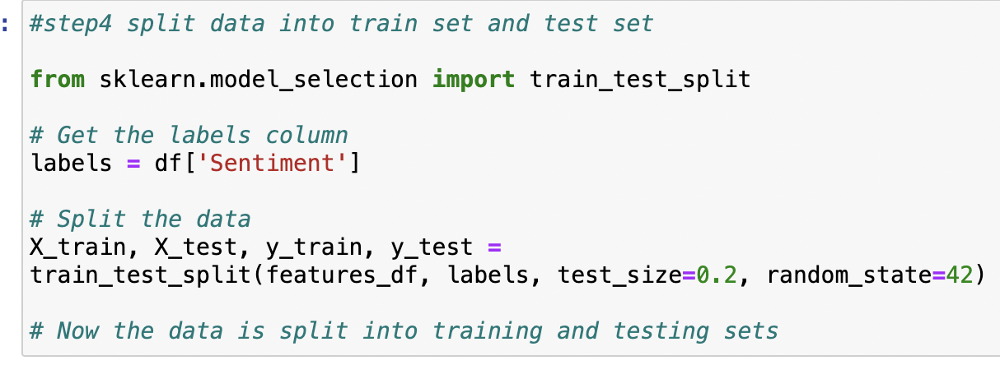
SVM Classification
Figure 11 Model Splitting and Selection for SVM
Figure 12 Derivation of the model accuracy with SVM

Slide 11
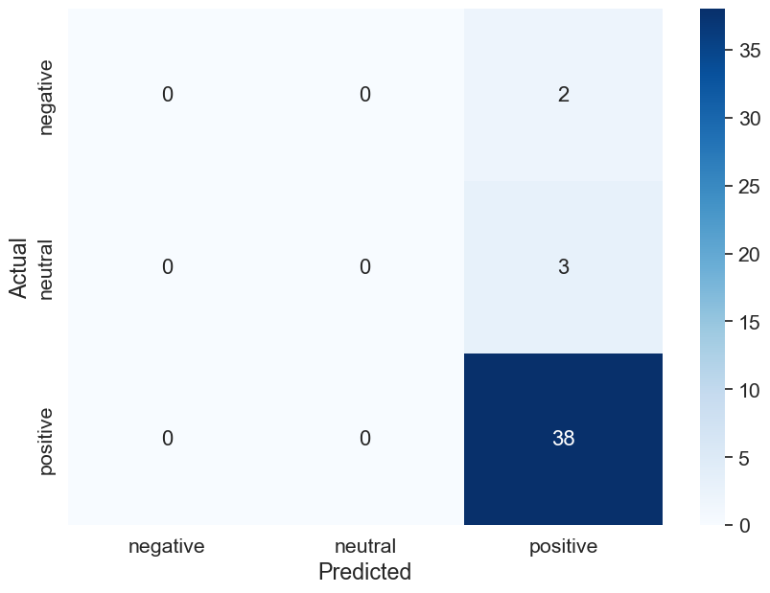
Naive Bayes Classifier: Confusion Matrix
For the y_pred and y_test, there will be bias, so we formed the matrix. Here because it is not binary, so we need to judge the TF, TN, FP, FN
Set [2,2] as TP, [0,2], [1,2] are TN, [0,0], [1,1] FP, the others are FN
Figure 13
Confusion Matrix

Slide 12
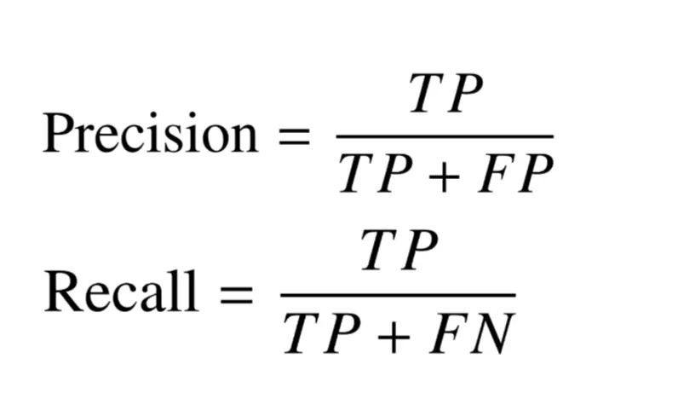

Performance Metrics: Precision
Figure 14a
Equation for Precision
How often an ML model is correct when predicting the target class.
Independent of accuracy
Low precision score (test data) → the classifier contains high number of False positives.
Imbalanced class or untuned model hyperparameters.
Use data that is more specific to the target predicting variable.
Remarks:
Macro average - arithmetic mean of the individual class related to precision.
Treat all classes equally to evaluate the overall performance of the classifier against the most common class labels.
Figure 14b Training and test data for precision

Slide 13

Performance Metrics: Recall
Figure 15a
Equation for Recall
Whether an ML model can find all objects of the target class
Low recall score (test data) → high number of false negatives
Imbalanced class or untuned model hyperparameters
More data collection, fine-tuning model hyperparameters, implementing class weights, ensembling → improve the recall score
Figure 15b Training and test data for recall output
Remarks:
Macro average - arithmetic mean of the individual class related to recall.
Treat all classes equally to evaluate the overall performance of the classifier against the most common class labels.

Slide 14
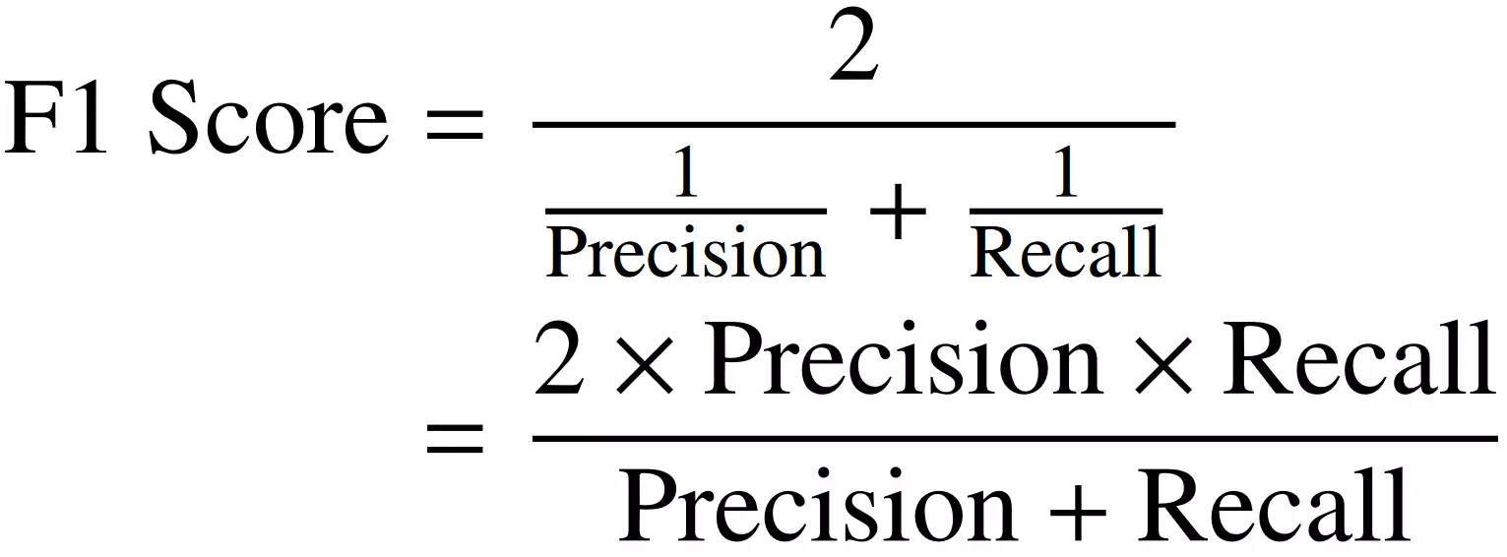

Performance Metrics: F1-Score
Figure 16a
Equation for F1 Score
Evaluation metric in binary and multi-class classification.
Better performance metrics than accuracy → imbalanced classes
Low F1 Score → Low Precision and Low Recall for test data
Imbalanced dataset, i.e. class 2 (positive) → represented significantly more frequently than the other (from confusion matrix in slide 10)
Model struggle learning to distinguish the minority class → poor performance
Over/under-sampling of dataset for combating imbalanced class is required
Figure 16b Training and test data for F1 Score output
Remarks:
Macro average - arithmetic mean of the individual class related to F1 score.
Treat all classes equally to evaluate the overall performance of the classifier against the most common class labels.

Slide 15
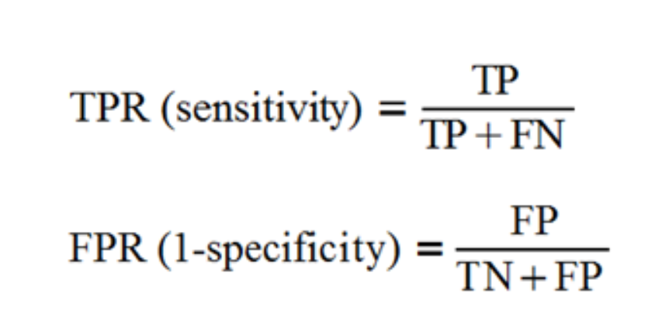
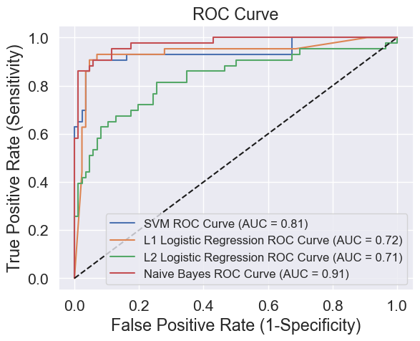
Performance Metrics: ROC & AUC
AUC (0-1): The area under the ROC curve → Higher AUC, better performance
ROC curve: Mapping the TPR and FPR from the confusion matrix under different thresholds
Not affected by imbalanced class → ROC curves are based on TPR and FPR, which are independent of class distribution
Figure 17a
Equation for TPR and FPR
Figure 17b
ROC Curve and AUC
Remarks (in the Python codes):
One-vs-Rest (OVR): Transform the ternary classification problem into three binary classification problems
Figure 17c
Binarizing multiclass labels

Slide 16
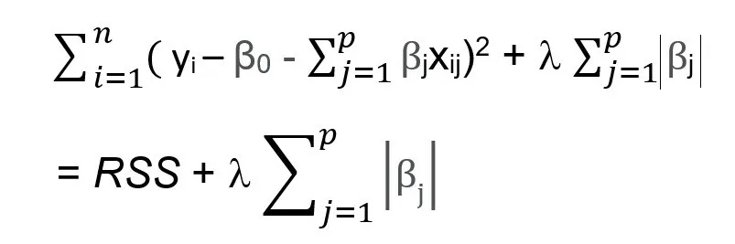
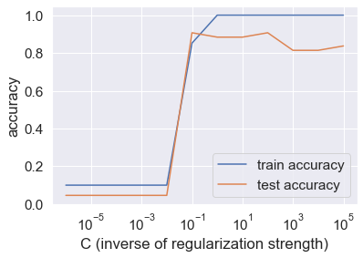
L1 Logistic Regression (LASSO)
Encourages simple, sparse models (fewer parameters).
Reducing the coefficients of less important features to zero
Limitation: all features have the same level of importance
Small C → greater accuracy
Training and testing accuracy → increase as C increase
Generalize well in unseen data
Figure 18a
L1 Logistic Regression formula
Figure 18b
L1 Logistic Regression
C → set as 0.1

Slide 17
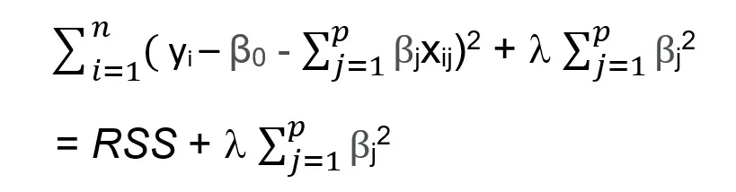
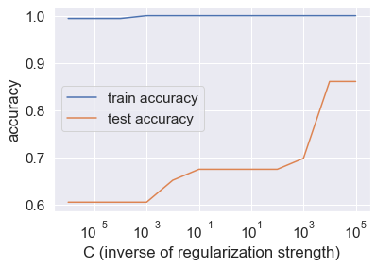
L2 Logistic Regression (Ridge)
Reduce S.E. by adding some bias in the regression estimates.
Handle multicollinearity, less sensitive to outliers
Prevent overfitting: shrink weights
Lower complexity of model
Limitation: retain all features in the model, only lead the coefficient to become close to zero
Small C → greater accuracy
Reduce model performance if the value of C is set too large.
Figure 19a
L2 Logistic Regression formula
Figure 19b
L2 Logistic Regression
C → set as 0.1

Slide 18
Conclusion and Limitations
Conclusion
Compared performance of four models in sentiment analysis
Imbalanced classes, with low precision, recall and F1 Score.
Provide quantitative insights to various social media users.
Outliers → inflated penalty values → affect model performance (L1/L2 regularization)
Limitation and Suggestions
Cover more language background to address diversity of comments problem
More amount of data and training should be collected and conducted.
Remove layers and neurons to decrease the complexity of the model
Ensembling - better overall predictive performance on predictive modeling problem.

Slide 19
Reference List
Huilgol, P. (n.d.). Essential Metrics for Machine Learning (2023 Update). Analytics Vidhya. https://www.analyticsvidhya.com/blog/2020/09/precision-recall-machine-learning/
Sakib, A.S. (2022). Scrape Youtube Comments For Free (No Google API). Kaggle. https://www.kaggle.com/code/ahmedshahriarsakib/scrape-youtube-comments-for-free-no-google-api/output
Tariq, A. (n.d.). What is the difference between micro and macro averaging? Educative. https://www.educative.io/answers/what-is-the-difference-between-micro-and-macro-averaging

Slide 20
Role List
 | Brian Lee | Zhu Jiawei | James Xie Ziyang | Yeung Cho Ho
Problem Description, Research Objective
Tabulation
Data Cleaning
Data Preprocessing
TF-IDF Vectorizer
Label Encoding
SVM Classification
Naive Bayes Classifier: Confusion Matrix
Performance Metrics: Precision
Performance Metrics: Recall
Performance Metrics: F1 Score
Performance Metrics: ROC and AUC
L1 Logistic Regression (Lasso)
L2 Logistic Regression (Ridge)
Conclusion and Limitation

